Slide 1
Current Coupon Model

Slide 2
Primary & secondary MBS market
Step 1:
Rate Lock Volumes
Predict Pull Thru
Hedge pipleline
Step 2:
Close Loans
Send Loans to GSE’s
Receive Cusips
Step 3:
Sell CUSIPs to Street
Buyback TBA
Step 4:
Dealers sell CUSIPS to investors
GSE’s
CUSIPs
Loans & Fees
Homeowners
Originators
Investors
Cash
Mortgage
Sell TBA
To Hedge Pipeline
TBA
CUSIPs
Cash/TBA
CUSIPs/TBA
Primary Dealers

Slide 3
current coupon definition
Coupon of Par priced TBA
Usually calculated by interpolating two TBA coupons whose prices straddle par.
Constant 30 or 45 days forward
Headline indicator of Agency MBS performance

Slide 4
Marking methodology
1. Calculate 30d (45d) constant forward price + accrued interest from front and back 1 TBA for each coupon
2. Find lower and upper coupon TBA based on 30d forward price + accrued interest
Front
SD_{F}
Back 1
SD_{B1}
Back 2
SD_{B2}
Back 3
AD
SD_{B3}

Slide 5


Marking methodology (cont.)
Interpolation is straightforward if both discount and premium forward prices are available
If either is not available, options are
1. Linear extrapolation (instable, missing convexity)
2. Implied/Regress by coupon swap (numerical instable)
3. Quadratic regression by (premium/discount coupon – cc) over (px over par)
Convert to bond equivalent yield
$$x=\frac{{SD}_{B1}− (AD+30)}{{SD}_{B1}−{SD}_{F}}$$
$$P_{30d}=x∙P_{F}+\left(1−x\right)∙P_{B1}+c∙\frac{d}{360}$$

Slide 6
Marking methodology (cont.)
Collect 100 business days TBA data for the 3 cheapest premium TBA
Regress a quadratic function over points defined as (TBA coupon – current coupon, TBA price -100.0) without intercept

Slide 7
Marking methodology (cont.)
A reliable cc marking should
Reflect MBS return correctly
Reflect market volatility
a good start for cc modeling
More accurate risk measures

Slide 8
Current Coupon Model
Forward *projection* of cc, most important MBS model component
Econometrics based model (Q2): historical time series analysis
Pricing based model (Q3): risk neutral/backward induction

Slide 9
Regression
Fundamental approach
cc(t) ~ intercept + CMT10y(t) + slope_2y10y(t) + histVol(t) + impVol(t)
cc(t) ~ intercept + CMS2y(t) + CMS10y(t)
cc(t) ~ CMS2y(t) + CMS5y(t) + CMS10y(t) + CMS30y(t) + basis(t)
cc(t) ~ CMS2y(t) + CMS5y(t) + CMS10y(t) + 1x10swaption Vol(t) + basis(t)
basis(t) ~ basis_LT + beta^t * (basis(0) – basis_LT)

Slide 10
Regression
Risk sensitivity approach
Δcc(t) ~ PCA1(t) + PCA2(t)
PCA1, PCA2 ~ ΔCMS2y, ΔCMS5y, ΔCMS10y, ΔCMS30y

Slide 11
Pricing based
MOATS (Mortgage Option-Adjusted Term Structure Model)
Endogenous approach base on the following heuristic relationship
Mortgage Rate
Prepayment Speed
Current Coupon
TBA/Pool Valuation

Slide 12

Endogenous approach
$$P=f\left(OAS, r_{i}, coupon, WAC …\right)$$
$$100=f\left(OAS, r_{i}, cc, cc+WAC spread …\right)$$
$\frac{∂f}{∂r_{i}}+\frac{∂f}{∂cc}\frac{∂cc}{∂r_{i}}+\frac{∂f}{∂coupon}\frac{∂cc}{∂r_{i}}=100$
$$\frac{∂cc}{∂r_{i}}=−\frac{{Par}_{i}}{\frac{∂f}{∂coupon}}$$
Discount Effect
Prepay Change
Coupon
Shift

Slide 13
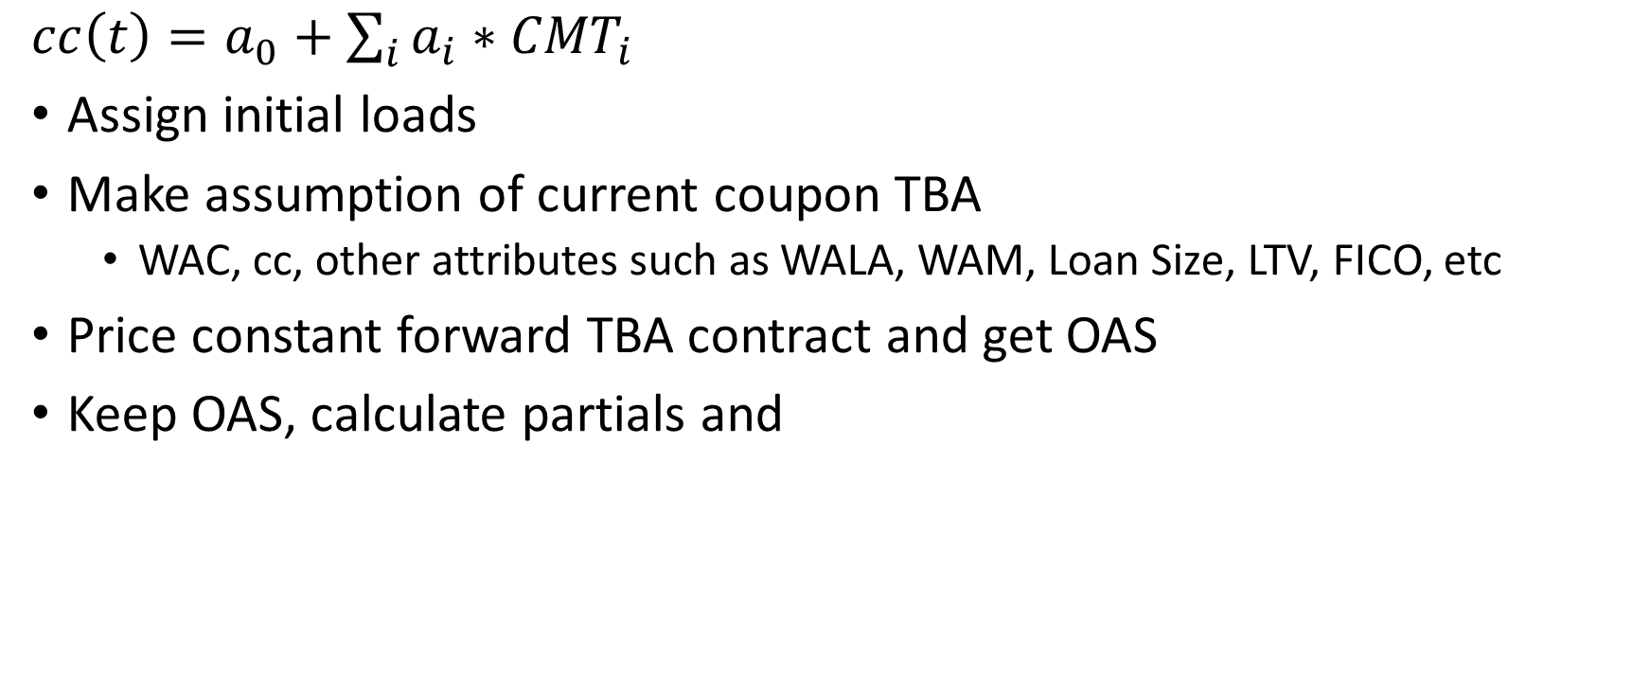
Algorithms
$cc\left(t\right)=a_{0}+\sum_{i}{a_{i}}∗{CMT}_{i}$
Assign initial loads
Make assumption of current coupon TBA
WAC, cc, other attributes such as WALA, WAM, Loan Size, LTV, FICO, etc
Price constant forward TBA contract and get OAS
Keep OAS, calculate partials and

Slide 14
Advantages
Coherent approach
Nonlinearity is embedded
Not based on any history cc/rate relation (except prepayment model should be) which dynamics could change over time
Constant basis assumption vs constant OAS for current coupon
Most empirical cc models are based on constant spread
Constant cc OAS is a much better assumption (lower vol) by empirical data

Slide 15
Potential tests
Heuristic approach depends on prepayment model
Depends on but not very sensitive to model performance as long as it is reasonably good
Depends on the way incentive is defined:
Popular definition is PV of monetary savings, then save moneyness will mean less incentive in higher rate environment due to discounting
Depends on term structure model
Normal vs lognormal model
How interest rate volatility skew is modeled
Require close monitoring potentially frequent re-calibration

Slide 16
First Constant Assumption
Constant TBA assumption(monthly TTB observable for dealers)
T0 constantness, does not mean it is static
W2D, most convexity, worst carry depends on premium/discount and it could change dramatically over time
Excludes most spec stories with a payup
Fast deliverables for premium – big bal, high fico, fully ramped but not seasoned enough
Most extendable for discount – big bal, low fico,
WAC spread could change dramatically over time
Market driven (best execution depends on
coupon swap
buy up/buy down multiplies
MSR valuation vs buyup (widen when excess IO MSR valuation is rich)
Policy driven (UMBS cap on WAC spread, widen)

Slide 17
TBA Assumptions in use
WAC = current coupon + wac_spread (115 bps), much higher wac spread
WALA ~ 20-30, fully ramped
Lnsz = 300K, much higher avg loan size recently
Ltv = 70 ~ 75
Fico = 750
State = US (non NY)
Purpose = Refi (usually should be purpose break down by %)
Occupancy = investor (purpose break down by occupancy %)

Slide 18
Second Constant Assumption
Constant cc OAS – Often referred as risk neutral in mortgage world
Means OAS is independent of rates level, slope and volatility,
Doesn’t mean OAS can’t change with other factor of the market
Foundation of option adjusted analysis
Constant OAS and parallel rate shock
Mortgage does not trade rate directional
Show OAS change vs PCA1/PCA2

Slide 19
Mortgage Basis vs OAS
Two valuation measures commonly referred by MBS investors
Measure cheapness or richness of mortgage from a historical standard point of view or a relative point of view, comparing with other assets
mortgage basis which is cc over blend of treasuries/swaps is model independent; usually over 5 year treasury or 10 year treasury or blend of the two; which does not track the cc duration all the time
OAS is common model based analysis which accounts for timing of the cashflow, interest rate volatility, and optionality
Pros and Cons
Basis is straight forward and model independent
OAS is model dependent and it takes into account for cc duration and convexity changes over time

Slide 20
Mortgage Basis Drivers
Swap spread
Curve slope
Interest rate vol (such as swaptions)
Refinance propensity
Performance of competing spread products, such as IG-spread
Basis is straight forward and model independent
OAS is model dependent and it takes into account for cc duration and convexity changes over time
Risk appetite
Widen during crisis due to flight-to-safety
Monetary policy
Dynamics gets tricky when fed purchased MBS and treasury at the same time with QEs(tailwind to both mortgages and treasury)

